Slide 1
Java, with a Clojure mindset
@DanLebrero
www.akvo.org

Slide 2
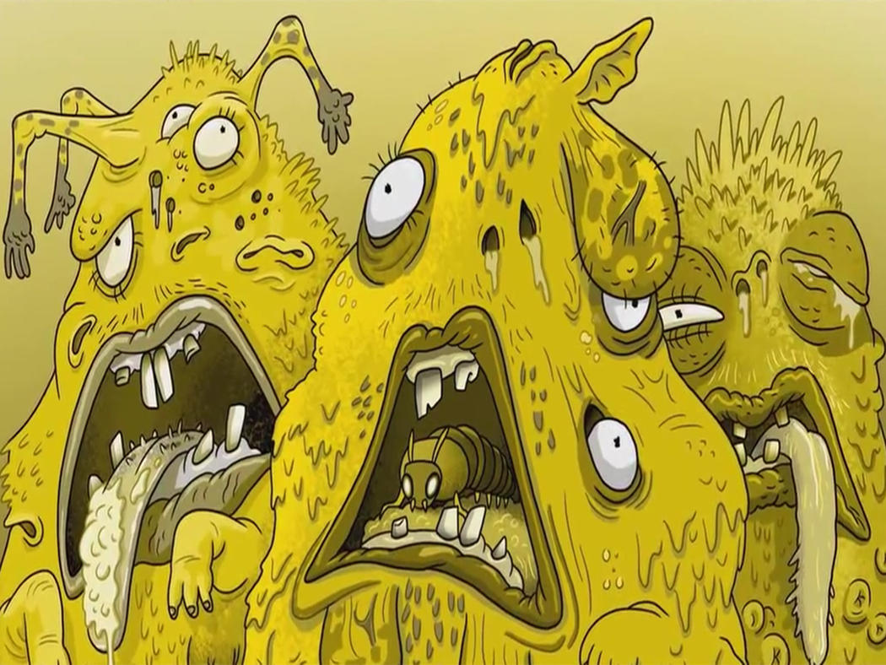

Slide 9
((((((
((((((()))))))
))))))

Slide 10
Clojure
Functional
Hosted
Dynamic
Strongly typed
Lisp

Slide 13
Give 10$ free cash
if client makes 1000 bets
in less than 1 week

Slide 14
Functional (vs OO)

Slide 15
Pure Functions

Slide 16
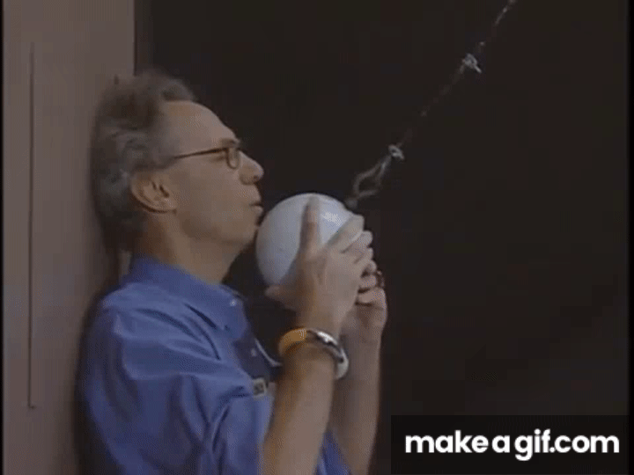

Slide 17
“Programmers are constantly in maintenance mode.”
― The Pragmatic Programmer

Slide 18
Side Effects

Slide 19
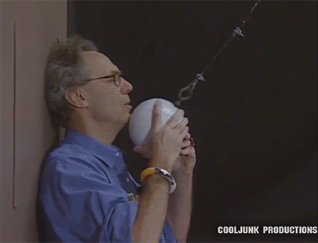

Slide 20
Side effects are the enemy

Slide 21
Side Effects
State
IO
Co-effects
Effects

Slide 22
State

Slide 23
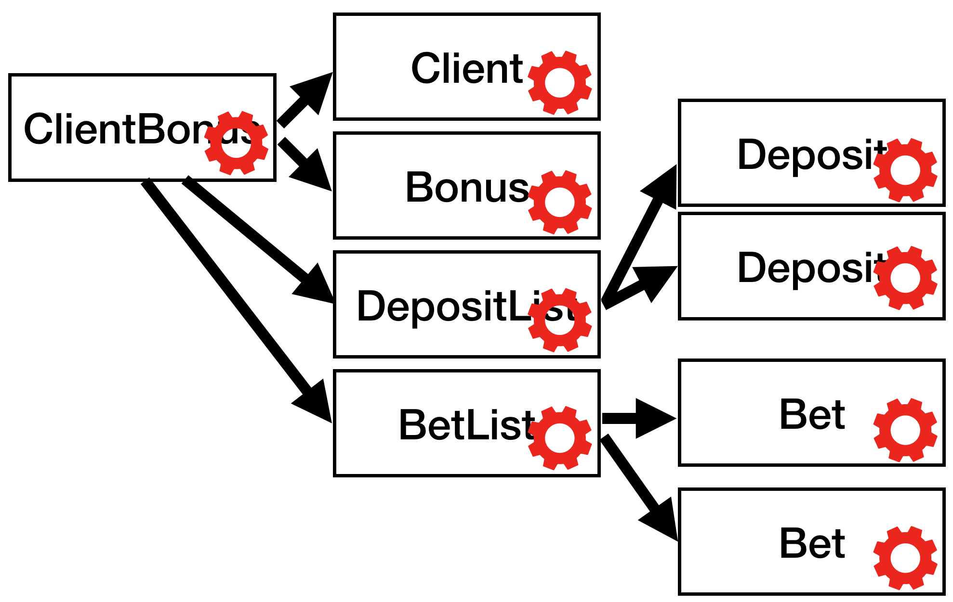
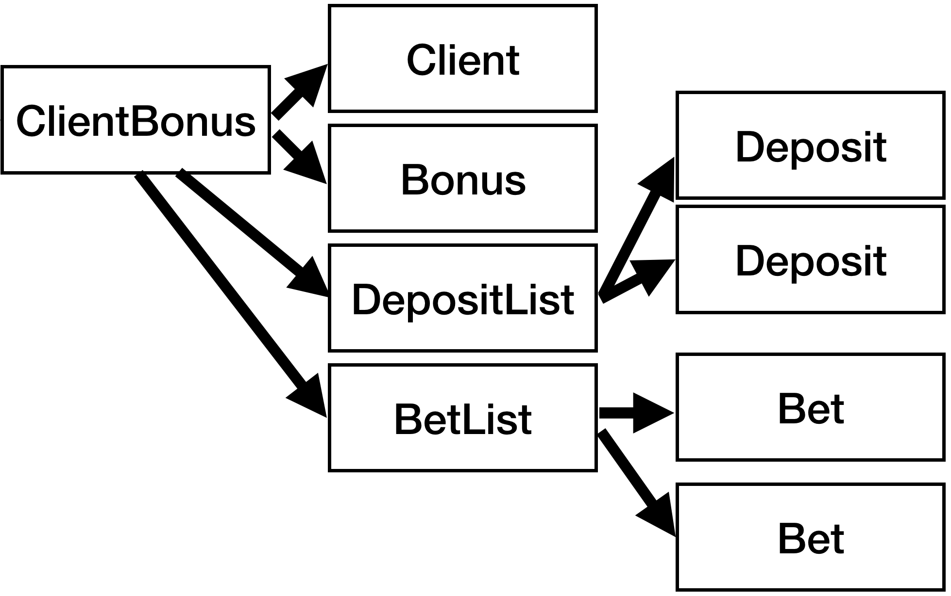
Client
12
23
54
…
ClientBonus
Deposit
Bonus
Deposit
DepositList
BetList
Bet
Bet

Slide 24
Atom
=~ j.u.c.a.AtomicReference

Slide 25
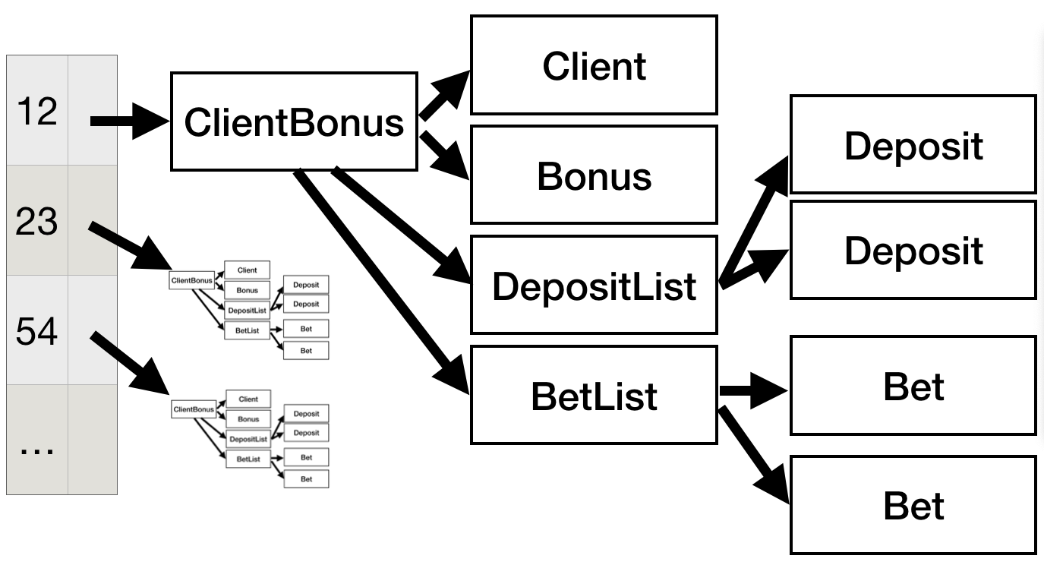
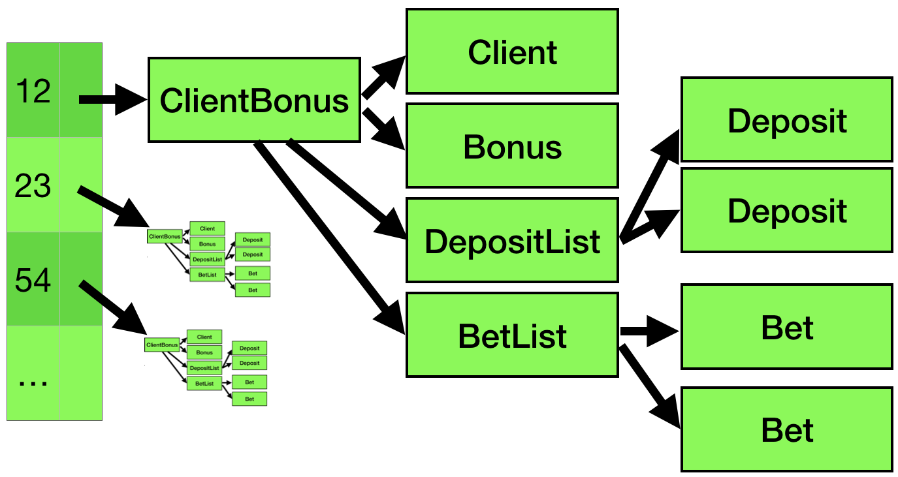
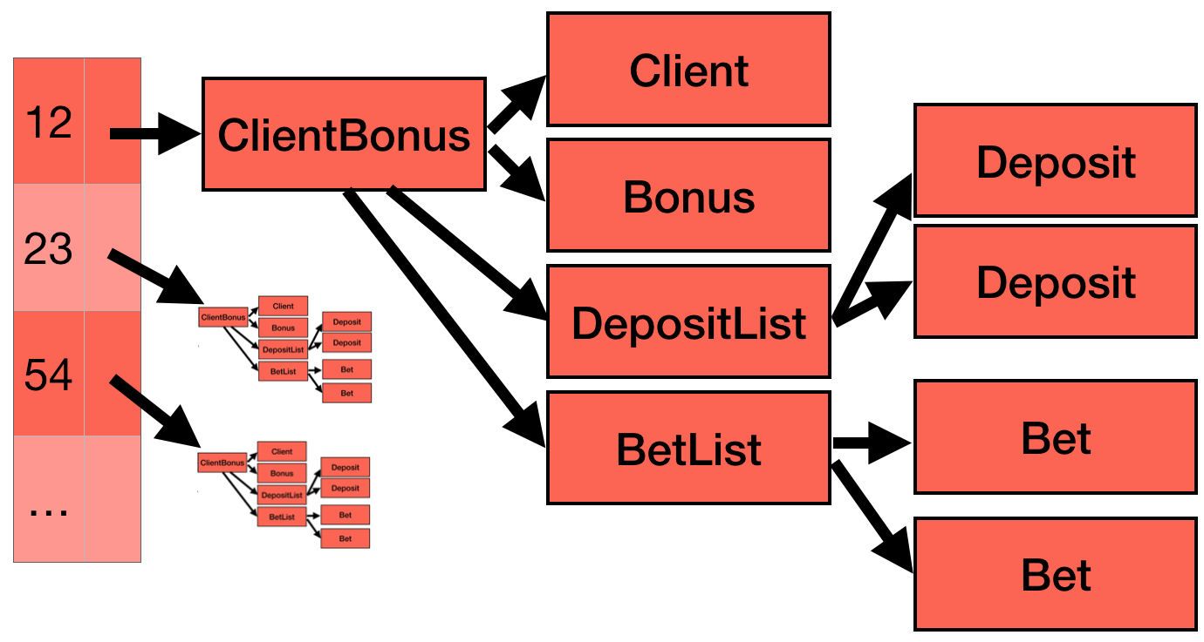
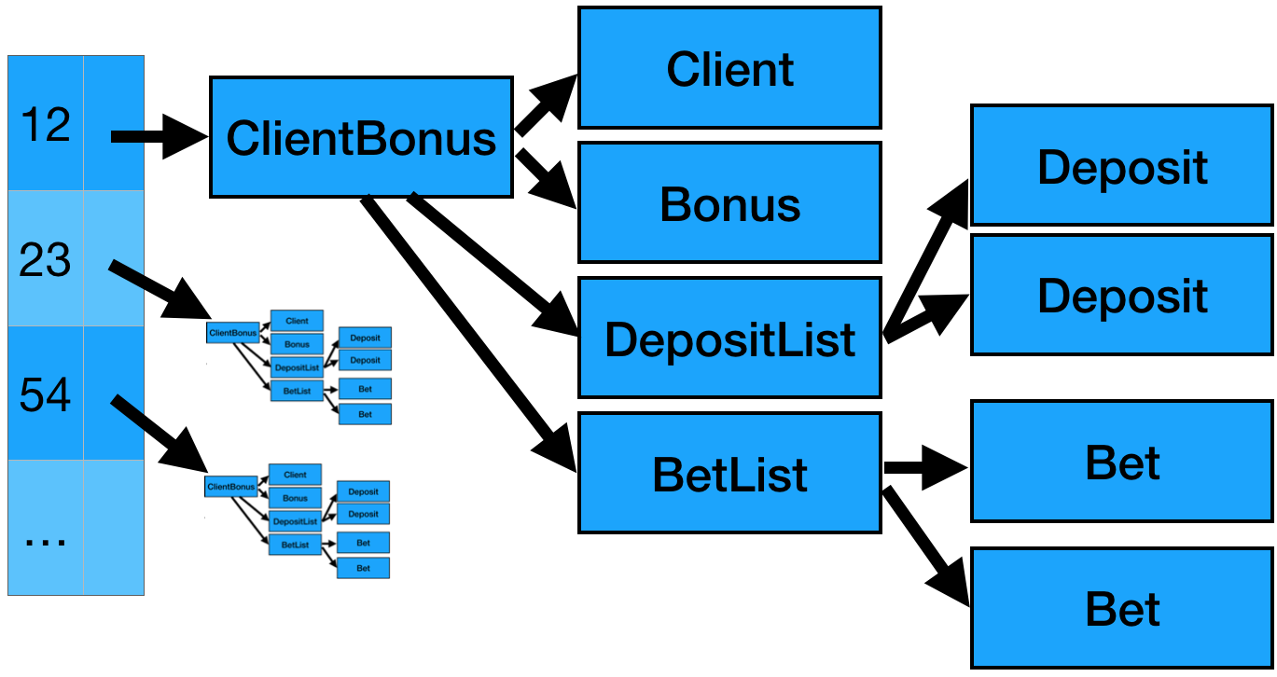
Atom
==?
Thread-1
==?
==?
fn1( ) =
Thread-2
fn2( ) =
====
fn2( ) =

Slide 26
Atom
Thread-1
X
Thread-2

Slide 27
Atom
Thread-1
Thread-2
Thread-3

Slide 28
Client
12
23
54
…
12
23
54
…
ClientBonus
ClientBonus
Deposit
Bonus
Deposit
DepositList
BetList
Bet
BetList
Bet
Bet

Slide 29
“Is this thread safe?”
― Every Java developer, every day.

Slide 30
State is consistent
Function must be pure
Only safe within the pure function

Slide 31
public class ClientBonus {
private final Client client;
private final Bonus bonus;
private final DepositList deposits;
…

Slide 32
Client
12
23
54
…
ClientBonus
Deposit
Bonus
Deposit
DepositList
BetList
Bet
Bet

Slide 33
public interface ConcurrentMap<…> extends Map<…> {
V compute(K key, BiFunction<…> remappingFunction)
V computeIfAbsent(K key, Function<…> mappingFunction)
V computeIfPresent(K key, BiFunction<…> remappingFunction)
…
}

Slide 34
public class TheStateHolder {
private final Map<Long, ClientBonus> state = new ConcurrentHashMap<>();
public ClientBonus nextState(Long client, Bet bet) {
return state.computeIfPresent(
client,
(k, currentState) -> currentState.nextState(bet));
}

Slide 35
public class ClientBonus {
private final Client client;
private final Bonus bonus;
private final DepositList deposits;
public ClientBonus nextState(Bet bet) {
...
}
…

Slide 36
Effects

Slide 37
TheStateHolder
xxxxService
INotificationSender
NotificationSenderImpl

Slide 38
public class ClientBonus {
private final Client client;
private final Bonus bonus;
private final DepositList deposits;
public ClientBonus nextState(Bet bet) {
...
}
…

Slide 39
public class ClientBonus {
private final Client client;
private final Bonus bonus;
private final DepositList deposits;
public Pair<ClientBonus,Effects> next(Bet bet) {
...
}
…

Slide 40
NotifyClientEffect

Slide 41
IgnoreError
NotifyClientEffect

Slide 42
IgnoreError
StopTheJVM
NotifyClientEffect
NotifyClientEffect

Slide 43
SequentialEffects
Effect1
Effect2
Effect3

Slide 44
Effect1
IndependentEffects
Effect2
Effect3

Slide 45
StopTracking
Pay
NotifyClient

Slide 46
public interface Effect {
void run(AllDependencies dependencies);
}

Slide 47
Pair<ClientBonus, Effects> pair = theStateHolder.nextState(bet);
pair.effects.run(dependencies);

Slide 48
Pair<ClientBonus, Effects> pair = theStateHolder.nextState(bet);
pair.effects.run(dependencies);
“Is this thread safe?”

Slide 49
Thread-1
Pair<> pair = theStateHolder.nextState(bet);
Pair<> pair = theStateHolder.nextState(bet);
pair.effects.run(dependencies);
pair.effects.run(dependencies);
Thread-2

Slide 50
Thread-1
Pair<> pair = theStateHolder.nextState(bet);
Pair<> pair = theStateHolder.nextState(bet);
pair.effects.run(dependencies);
pair.effects.run(dependencies);
Thread-2
Thread-2
Thread-1

Slide 51
Agents (=~~~ Actors)

Slide 53
Can I pay?
Can I pay?
Can I pay?
ACID

Slide 54
Yes
No
No

Slide 55
AtMostOnce
StopTracking
Pay
NotifyClient

Slide 56
Co-Effects

Slide 58
Event Sourcing
Functional Programming

Slide 59
Event Sourcing
Functional Programming

Slide 60
public class KafkaConsumer {
private AllDependencies allDependencies;
private TheStateHolder theStateHolder;
public void run() {
while (!stop) {
Bet bet = readNext();
Effects effects = theStateHolder.event(bet);
effects.run(allDependencies);
}
}
…
}

Slide 61
public class KafkaConsumer {
private AllDependencies allDependencies;
private TheStateHolder theStateHolder;
public void run() {
while (!stop) {
Bet bet = readNext();
Effects effects = theStateHolder.event(bet);
effects.run(allDependencies);
}
}
…
}

Slide 62
public class KafkaConsumer {
private AllDependencies allDependencies;
private TheStateHolder theStateHolder;
public void run() {
while (!stop) {
Bet bet = readNext();
Effects effects = theStateHolder.event(bet);
effects.run(allDependencies);
}
}
…
}

Slide 63
public class KafkaConsumer {
private AllDependencies allDependencies;
private TheStateHolder theStateHolder;
public void run() {
while (!stop) {
Bet bet = readNext();
Effects effects = theStateHolder.event(bet);
effects.run(allDependencies);
}
}
…
}

Slide 64
public class KafkaConsumer {
private AllDependencies allDependencies;
private TheStateHolder theStateHolder;
public void run() {
while (!stop) {
Bet bet = readNext();
Effects effects = theStateHolder.event(bet);
effects.run(allDependencies);
}
}
…
}

Slide 65
No getters
No locks or synch blocks
No try/catch
No logging
No mocks
No useless interfaces

Slide 66
Imperative
Shell
Functional Core
https://www.destroyallsoftware.com/screencasts/catalog/functional-core-imperative-shell

Slide 67
ClientBonus
INotificationSender
NotificationSenderImpl

Slide 68
Dynamic (vs Static) typing

Slide 69
clientBonus = Map.of(
"client", Map.of("id", "123233"),
"deposits",
List.of(
Map.of("amount", 3,
"type", "CASH"),
Map.of("amount", 234,
"type", "CARD")));
((List) clientBonus.get("deposits"))
.stream()
.collect(
Collectors.summarizingInt(
m -> (int) ((Map) m).get("amount")));

Slide 71
public class Bet { private String id; private int amount;
private long timestamp; }

Slide 72
“It is better to have 100 functions operate on one data structure than 10 functions on 10 data structures.”
― Alan Perlis

Slide 73
{:type :bet
:id "client1"
:amount 23
:timestamp 123312321323}

Slide 74
{:type :bet
:id "client1"
:amount 23
:timestamp 123312321323}
apply butlast concat cons count cycle diff distinct distinct? drop drop-last drop-while empty empty? every? ffirst filter first flatten fnext for frequencies group-by interleave interpose into into-array keep keep-indexed last lazy-cat map map-indexed mapcat next nfirst nnext not-any? not-empty not-every? nth nthnext partition partition-all partition-by pmap postwalk prewalk rand-nth reduce reductions remove replace rest reverse second seq? seque set shuffle some sort sort-by split-at split-with take take-nth take-while to-array-2d vec walk when-first assoc pop subvec replace conj rseq update-in update get get-in contains? find keys vals assoc assoc-in dissoc merge merge-with select-keys update-in update rename-keys map-invert reduce-kv dissoc-in disj join select project union difference intersection index

Slide 75
{:request-method :get :uri “/foobaz" :query-params {"somekey" “somevalue"} :headers {"accept-encoding" "gzip, deflate" "connection" "close"} :body nil
:scheme :http :content-length 0 :server-port 8080 :server-name “localhost"}
apply butlast concat cons count cycle diff distinct distinct? drop drop-last drop-while empty empty? every? ffirst filter first flatten fnext for frequencies group-by interleave interpose into into-array keep keep-indexed last lazy-cat map map-indexed mapcat next nfirst nnext not-any? not-empty not-every? nth nthnext partition partition-all partition-by pmap postwalk prewalk rand-nth reduce reductions remove replace rest reverse second seq? seque set shuffle some sort sort-by split-at split-with take take-nth take-while to-array-2d vec walk when-first assoc pop subvec replace conj rseq update-in update get get-in contains? find keys vals assoc assoc-in dissoc merge merge-with select-keys update-in update rename-keys map-invert reduce-kv dissoc-in disj join select project union difference intersection index

Slide 76
{:status 200 :headers {"Content-Type" "text/html"} :body "Hello World"}}
apply butlast concat cons count cycle diff distinct distinct? drop drop-last drop-while empty empty? every? ffirst filter first flatten fnext for frequencies group-by interleave interpose into into-array keep keep-indexed last lazy-cat map map-indexed mapcat next nfirst nnext not-any? not-empty not-every? nth nthnext partition partition-all partition-by pmap postwalk prewalk rand-nth reduce reductions remove replace rest reverse second seq? seque set shuffle some sort sort-by split-at split-with take take-nth take-while to-array-2d vec walk when-first assoc pop subvec replace conj rseq update-in update get get-in contains? find keys vals assoc assoc-in dissoc merge merge-with select-keys update-in update rename-keys map-invert reduce-kv dissoc-in disj join select project union difference intersection index

Slide 77
{:select [:id :client :amount] :from [:transactions] :where [:= :client "a"]}
apply butlast concat cons count cycle diff distinct distinct? drop drop-last drop-while empty empty? every? ffirst filter first flatten fnext for frequencies group-by interleave interpose into into-array keep keep-indexed last lazy-cat map map-indexed mapcat next nfirst nnext not-any? not-empty not-every? nth nthnext partition partition-all partition-by pmap postwalk prewalk rand-nth reduce reductions remove replace rest reverse second seq? seque set shuffle some sort sort-by split-at split-with take take-nth take-while to-array-2d vec walk when-first assoc pop subvec replace conj rseq update-in update get get-in contains? find keys vals assoc assoc-in dissoc merge merge-with select-keys update-in update rename-keys map-invert reduce-kv dissoc-in disj join select project union difference intersection index

Slide 78
[{:id 1 :client 32 :amount 3} {:id 2 :client 87 :amount 7} {:id 3 :client 32 :amount 4} {:id 4 :client 40 :amount 6}]
apply butlast concat cons count cycle diff distinct distinct? drop drop-last drop-while empty empty? every? ffirst filter first flatten fnext for frequencies group-by interleave interpose into into-array keep keep-indexed last lazy-cat map map-indexed mapcat next nfirst nnext not-any? not-empty not-every? nth nthnext partition partition-all partition-by pmap postwalk prewalk rand-nth reduce reductions remove replace rest reverse second seq? seque set shuffle some sort sort-by split-at split-with take take-nth take-while to-array-2d vec walk when-first assoc pop subvec replace conj rseq update-in update get get-in contains? find keys vals assoc assoc-in dissoc merge merge-with select-keys update-in update rename-keys map-invert reduce-kv dissoc-in disj join select project union difference intersection index

Slide 79
[:html [:body [:p "Count: 4"] [:p "Total: 20"]]]
apply butlast concat cons count cycle diff distinct distinct? drop drop-last drop-while empty empty? every? ffirst filter first flatten fnext for frequencies group-by interleave interpose into into-array keep keep-indexed last lazy-cat map map-indexed mapcat next nfirst nnext not-any? not-empty not-every? nth nthnext partition partition-all partition-by pmap postwalk prewalk rand-nth reduce reductions remove replace rest reverse second seq? seque set shuffle some sort sort-by split-at split-with take take-nth take-while to-array-2d vec walk when-first assoc pop subvec replace conj rseq update-in update get get-in contains? find keys vals assoc assoc-in dissoc merge merge-with select-keys update-in update rename-keys map-invert reduce-kv dissoc-in disj join select project union difference intersection index

Slide 80
{:web-server {:listen 8080} :db-config {:host "xxxx" :user "xxxx" :password "xxxx"} :http-defaults {:connection-timeout 10000 :request-timeout 10000 :max-connections 2000} :user-service {:url “http://user-service” :connection-timeout 1000}}
apply butlast concat cons count cycle diff distinct distinct? drop drop-last drop-while empty empty? every? ffirst filter first flatten fnext for frequencies group-by interleave interpose into into-array keep keep-indexed last lazy-cat map map-indexed mapcat next nfirst nnext not-any? not-empty not-every? nth nthnext partition partition-all partition-by pmap postwalk prewalk rand-nth reduce reductions remove replace rest reverse second seq? seque set shuffle some sort sort-by split-at split-with take take-nth take-while to-array-2d vec walk when-first assoc pop subvec replace conj rseq update-in update get get-in contains? find keys vals assoc assoc-in dissoc merge merge-with select-keys update-in update rename-keys map-invert reduce-kv dissoc-in disj join select project union difference intersection index

Slide 81
{:id :string :name :string :deposits [{:id :string :amount :int :timestamp :long}]}
apply butlast concat cons count cycle diff distinct distinct? drop drop-last drop-while empty empty? every? ffirst filter first flatten fnext for frequencies group-by interleave interpose into into-array keep keep-indexed last lazy-cat map map-indexed mapcat next nfirst nnext not-any? not-empty not-every? nth nthnext partition partition-all partition-by pmap postwalk prewalk rand-nth reduce reductions remove replace rest reverse second seq? seque set shuffle some sort sort-by split-at split-with take take-nth take-while to-array-2d vec walk when-first assoc pop subvec replace conj rseq update-in update get get-in contains? find keys vals assoc assoc-in dissoc merge merge-with select-keys update-in update rename-keys map-invert reduce-kv dissoc-in disj join select project union difference intersection index

Slide 82
Business logic
Infrastructure code
Configuration
Reflection/Metadata
apply butlast concat cons count cycle diff distinct distinct? drop drop-last drop-while empty empty? every? ffirst filter first flatten fnext for frequencies group-by interleave interpose into into-array keep keep-indexed last lazy-cat map map-indexed mapcat next nfirst nnext not-any? not-empty not-every? nth nthnext partition partition-all partition-by pmap postwalk prewalk rand-nth reduce reductions remove replace rest reverse second seq? seque set shuffle some sort sort-by split-at split-with take take-nth take-while to-array-2d vec walk when-first assoc pop subvec replace conj rseq update-in update get get-in contains? find keys vals assoc assoc-in dissoc merge merge-with select-keys update-in update rename-keys map-invert reduce-kv dissoc-in disj join select project union difference intersection index

Slide 83
Dynamic (vs Static) development

Slide 84
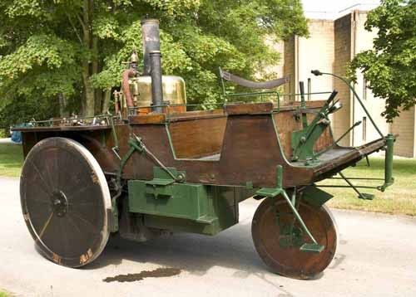
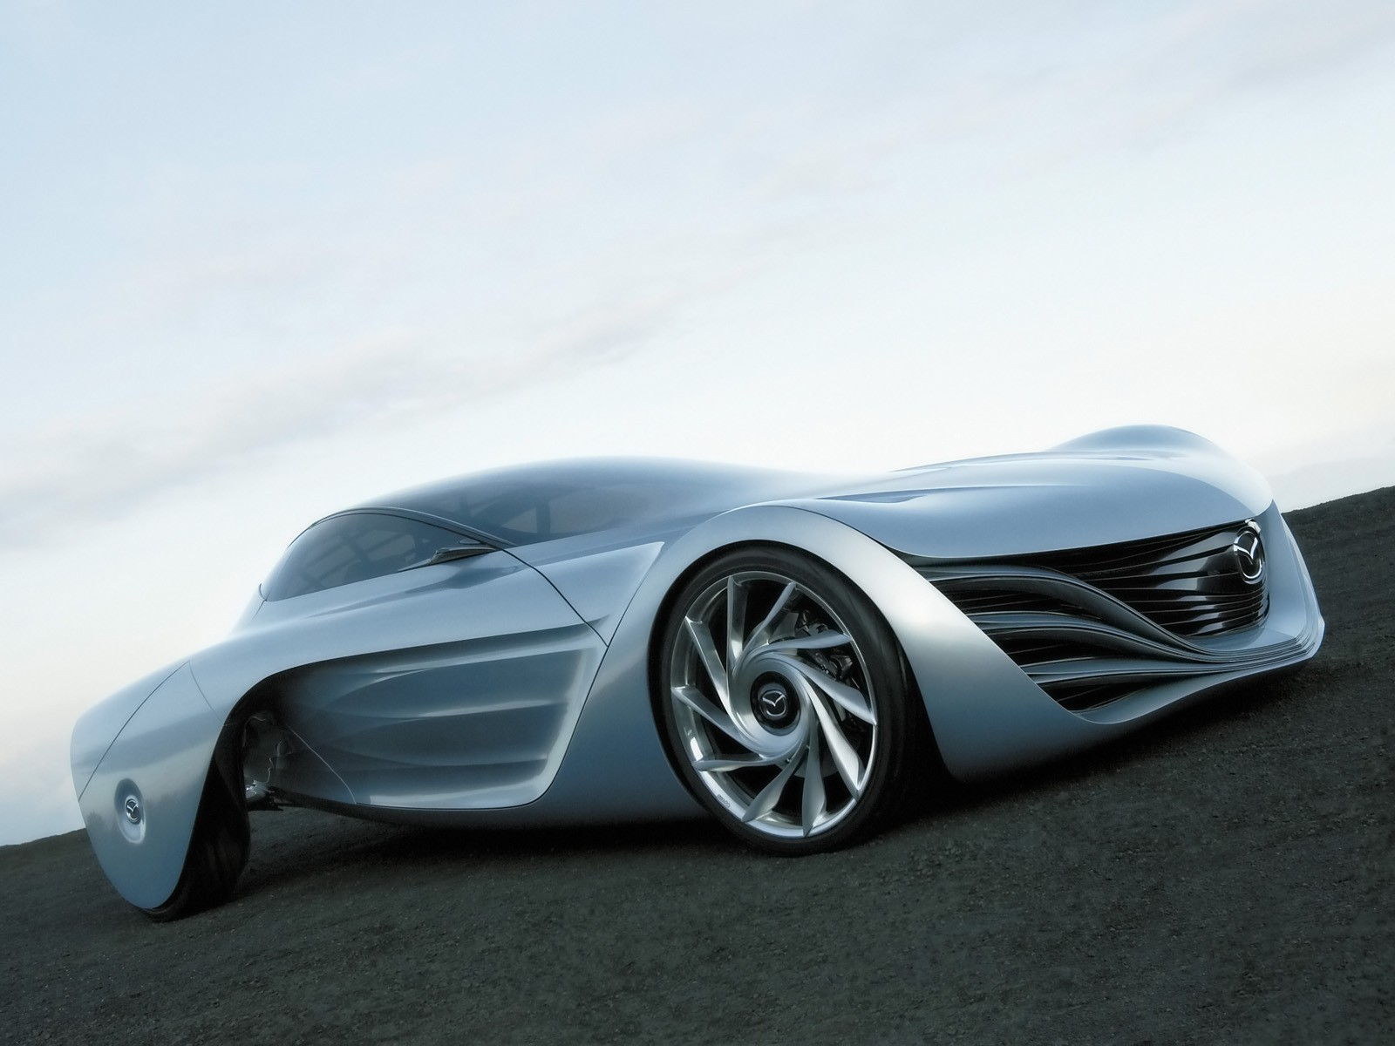
REPL

Slide 85
https://danlebrero.com/repl

Slide 86
Lisp (vs Fortan)

Slide 87
;
X

Slide 88
,
X

Slide 91
1
2
3
4
.filter(removeCsvHeaders(firstHeader))
.map(splitCsvString())
.map(convertCsvToMap(csvHeaders))
.map(convertToJson(eventCreator))
16
5
7
6
8
11
9
10
12
13
14
15
-40%!!!
1
2
10
(filter not-header?)
(map parse-csv-line)
(map (partial zipmap headers))
(map ->event)
3
4
5
6
7
8
9

Slide 92
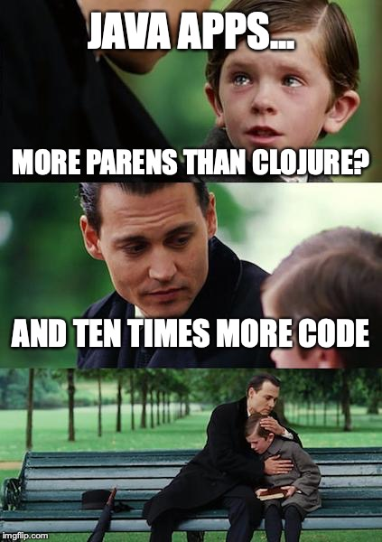

Slide 93
List.of(
new Symbol("defn"),
new Symbol("plus-one"),
List.of(
new Symbol("a"),
new Symbol("b")),
Map.of(
new Keyword("time"), List.of(new Symbol("System/currentTimeMillis")),
new Keyword("result"), List.of(
new Symbol("+"),
new Symbol("a"),
new Symbol("b"),
new Long(1))));

Slide 94
List.of(
new Symbol("defn"),
new Symbol("plus-one"),
List.of(
new Symbol("a"),
new Symbol("b")),
Map.of(
new Keyword("time"), List.of(new Symbol("System/currentTimeMillis")),
new Keyword("result"), List.of(
new Symbol("+"),
new Symbol("a"),
new Symbol("b"),
new Long(1))));
apply butlast concat cons count cycle diff distinct distinct? drop drop-last drop-while empty empty? every? ffirst filter first flatten fnext for frequencies group-by interleave interpose into into-array keep keep-indexed last lazy-cat map map-indexed mapcat next nfirst nnext not-any? not-empty not-every? nth nthnext partition partition-all partition-by pmap postwalk prewalk rand-nth reduce reductions remove replace rest reverse second seq? seque set shuffle some sort sort-by split-at split-with take take-nth take-while to-array-2d vec walk when-first assoc pop subvec replace conj rseq update-in update get get-in contains? find keys vals assoc assoc-in dissoc merge merge-with select-keys update-in update rename-keys map-invert reduce-kv dissoc-in disj join select project union difference intersection index

Slide 95
Summary

Slide 96
Imperative
Shell
Functional Core

Slide 97
DYNAMIC
STATIC
TYPES

Slide 98
STATIC
DYNAMIC
DEVELOPMENT

Slide 99
(((
)))

Slide 100
“A language that doesn’t affect the way you think about programming, is not worth knowing.”
― Alan Perlis

Slide 102
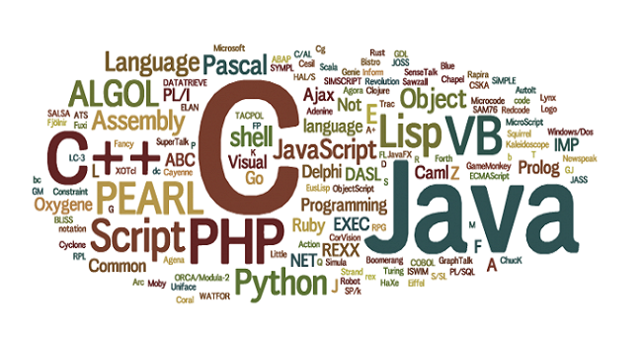

Slide 104
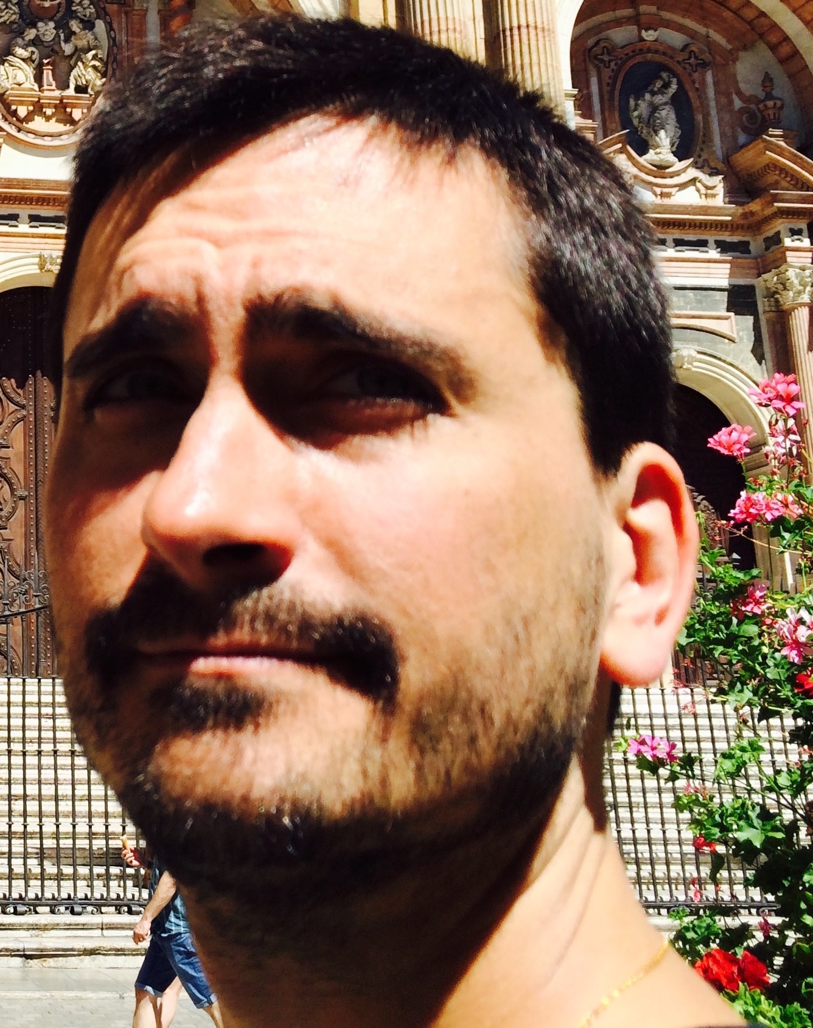
???
@DanLebrero
dlebrero@gmail.com
danlebrero.com
@Akvo
https://akvo.org/

Slide 106
Clojure is your friend
Clojure is happiness
Clojure is beauty
Come to Clojure
Cooomeeeee…

