Slide 1
Habits of efficient developers
@DanLebrero
www.akvo.org

Slide 2
efficient /ɪˈfɪʃ(ə)nt/
achieving maximum productivity with minimum wasted effort or expense.

Slide 3
“Efficiency is doing things right;
effectiveness is doing the right things.”
—Peter Drucker

Slide 4
1. Focus

Slide 6
1a. Disable ALL notifications

Slide 9
1b. Pair Programming

Slide 10
1c.
>

Slide 11
1d. One thing at a time

Slide 12
https://www.targetprocess.com/articles/speed-in-software-development/

Slide 13
multitasking
/ˌmʌl.tiˈtɑːs.kɪŋ/
Screwing up several things at once

Slide 14
2. Master your IDE

Slide 15
2a. Functionality
2b. Shortcuts

Slide 16
2c. Pair Programming

Slide 17
3. No menial work

Slide 20
YOU ARE A DEVELOPER

Slide 21
3a. Write programs
(for yourself)

Slide 22
Bash

Slide 23
https://xkcd.com/1205/

Slide 24
3b. Avoid GUIs

Slide 25
3c. Automate testing

Slide 26
3d. Repeatable Developer Environment

Slide 27
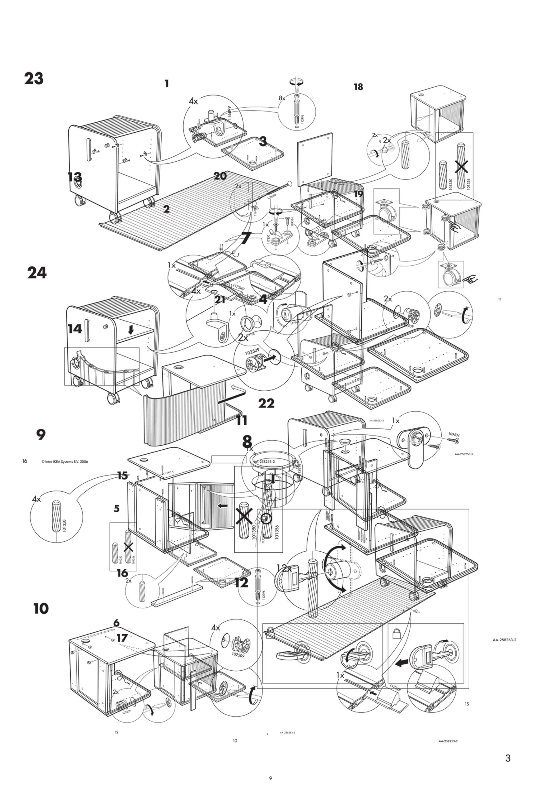
https://www.flickr.com/photos/jackbetty/4427395256

Slide 28
docker-compose up

Slide 29
services:
postgres:
build:
dockerfile: Dockerfile-postgres
expose:
- 5432
redis:
image: redis:3.2.9
our-app:
build:
dockerfile: Dockerfile-dev
ports:
- "3000:3000"

Slide 30
4. Fast feedback

Slide 31
4a. Test-Driven Development

Slide 32
Test
Refactor
Code

Slide 33
Seeing a test fail is the test that tests if the test tests what it is supposed to test

Slide 34
“I don’t know what I am going to build”
business?
business
side effects?
logic
side effects

Slide 35
4b. REPL

Slide 36
4c. Code reviews

Slide 38
4c. Code reviews

Slide 39
4c. Continuous code reviews

Slide 40
4c. Continuous code reviews
(Pair programming)

Slide 41
1. Focus
Disable notifications
Pair Program
Rest
One thing at a time
2. Master your IDE
Functionality
Shortcuts
Pair Program
3. No menial work
Write programs
Avoid GUIs
Automate testing
Repeatable dev env
4. Fast feedback
TDD
REPL
Pair Program

Slide 42
Stop
Reflect on how you work Never stop learning

Slide 43
???
@DanLebrero
dlebrero@gmail.com
danlebrero.com
@Akvo
https://akvo.org/

